Slide 1
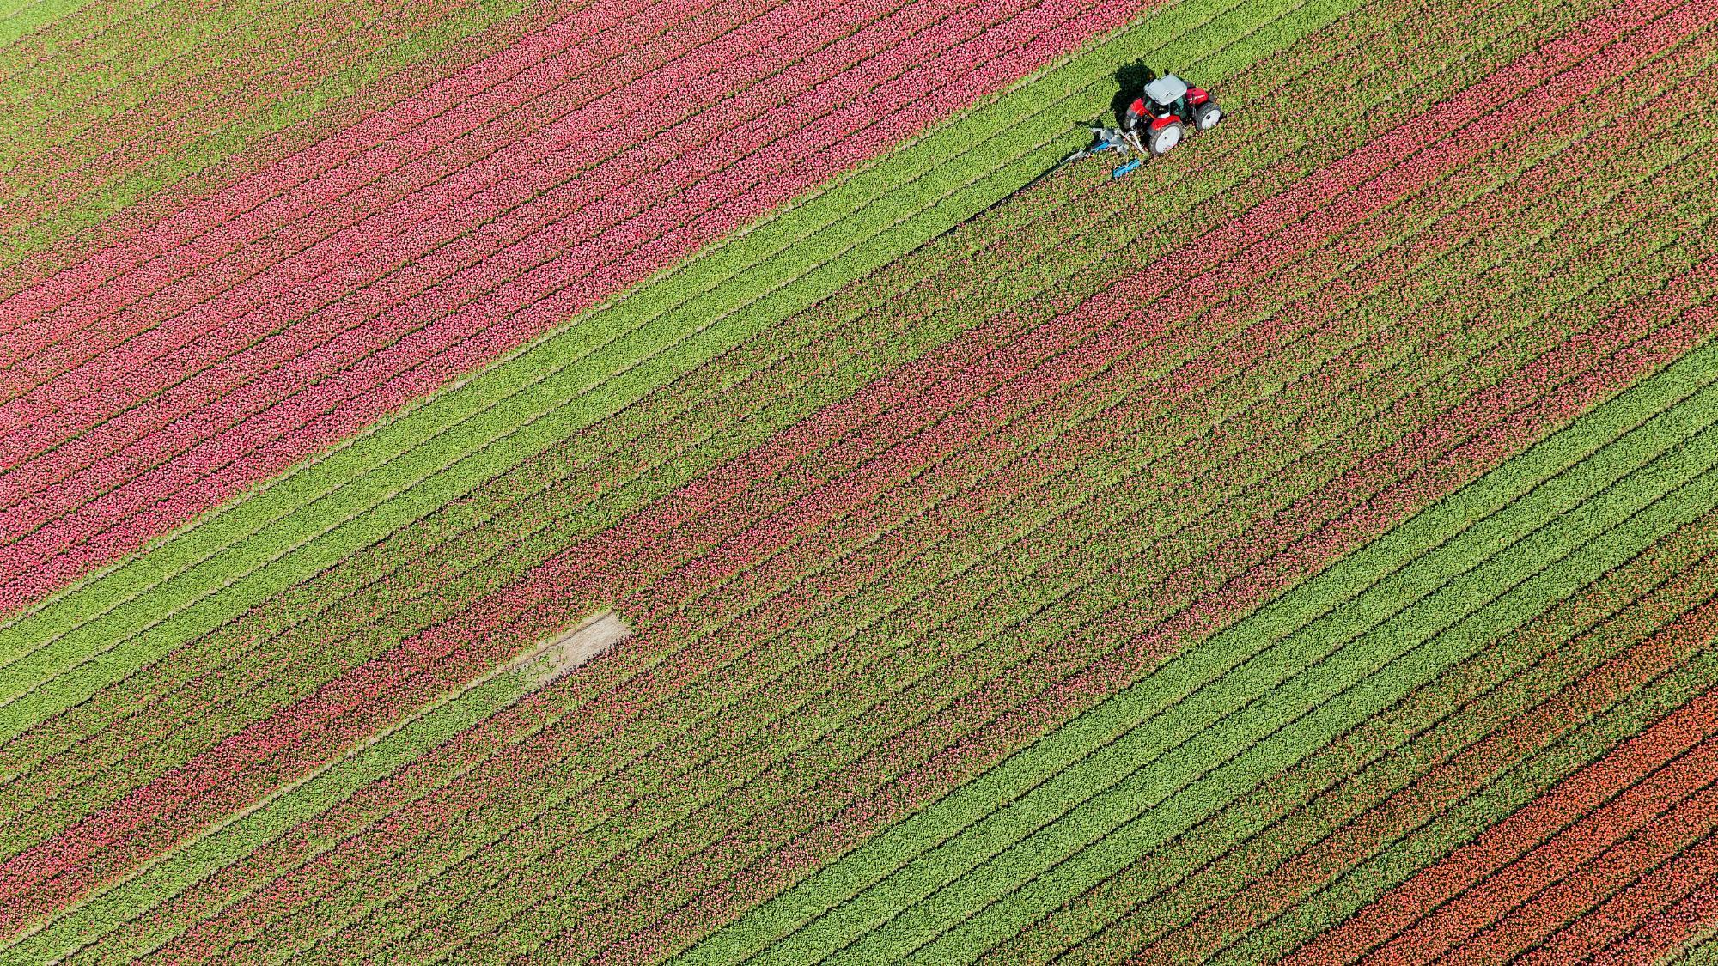
Principles of Sharing the Good News
As Taught by Jesus
Notes:
Gen to Rev (homework)
Luke 4 quotes re Jesus mission and Matt 4 example of him doing it.
Matt 28 game plan
Jesus Teaching on this Mark 4 and John 4

Slide 2
Matthew 4:23 (ESV)
And he went throughout all Galilee, teaching in their synagogues and proclaiming the gospel [euangelion] of the kingdom and healing every disease and every affliction among the people.
Εὐαγγελιστής - Euangelistés
Evangelist - A Good News Announcer
Luke 4:17a (ESV)
“The Spirit of the Lord is upon me, because he has anointed me to proclaim good news [euangelizo] to the poor...
Notes:
Luke 4 quotes re Jesus mission:
Luke 4:16–19 (ESV)
16 And he came to Nazareth, where he had been brought up. And as was his custom, he went to the synagogue on the Sabbath day, and he stood up to read. 17 And the scroll of the prophet Isaiah was given to him. He unrolled the scroll and found the place where it was written,
18 “The Spirit of the Lord is upon me,
because he has anointed me
to proclaim good news [euangelizo] to the poor.
He has sent me to proclaim liberty to the captives
and recovering of sight to the blind,
to set at liberty those who are oppressed,
19 to proclaim the year of the Lord’s favor.”
and Matt 4 example of him doing it:
Matthew 4:23 (ESV)
23 And he went throughout all Galilee, teaching in their synagogues and proclaiming the gospel [euangelion] of the kingdom and healing every disease and every affliction among the people.

Slide 3
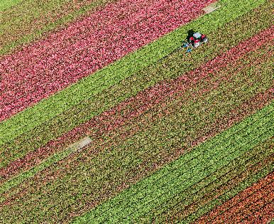
The Matthew 28 Game Plan
Matthew 28:18–20 (ESV)
18 And Jesus came and said to them, “All authority in heaven and on earth has been given to me.
19 Go therefore and make disciples of all nations, baptizing them in the name of the Father and of the Son and of the Holy Spirit,
20 teaching them to
observe all that I have commanded you.
And behold, I am with you always, to the end of the age.”

Slide 4
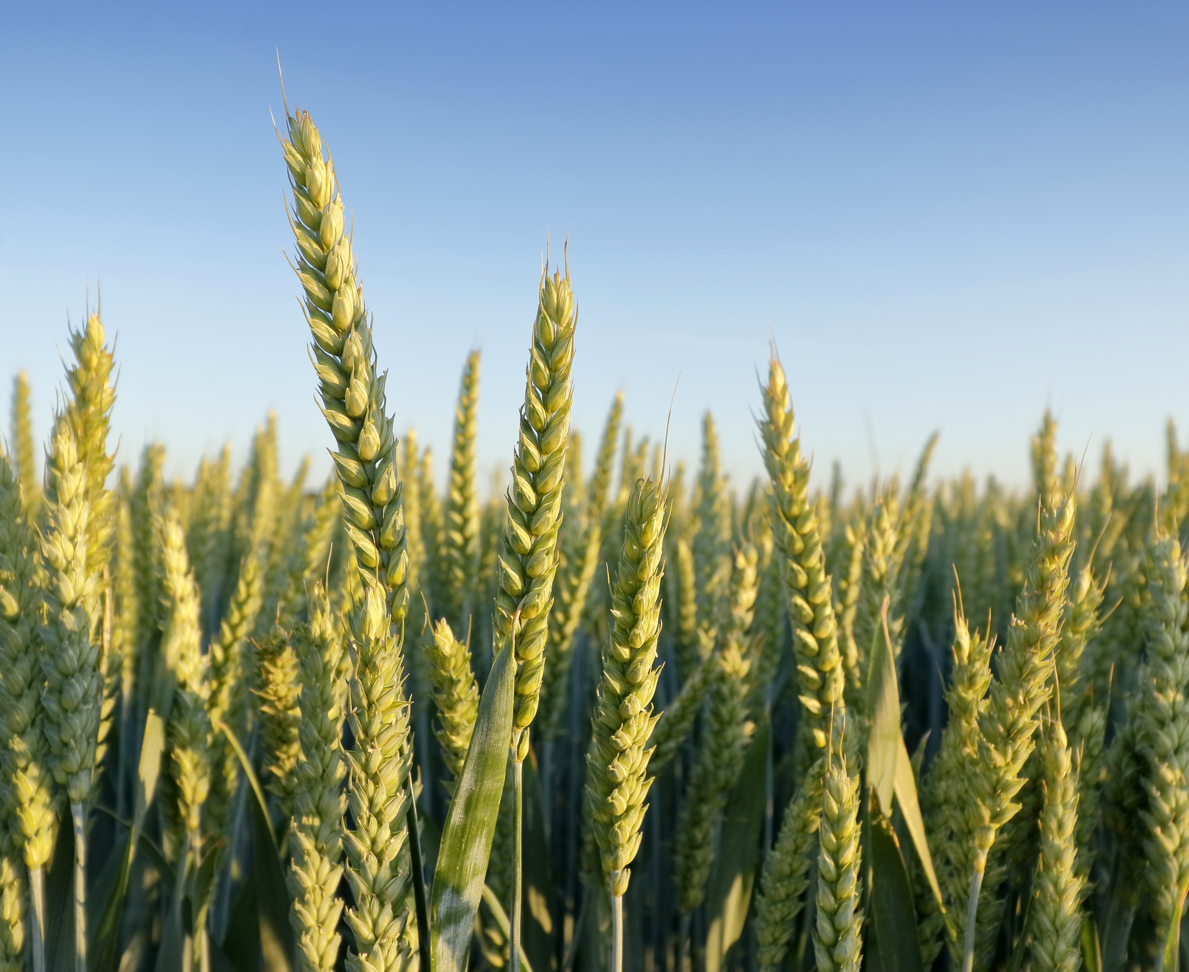
Mark 4
Mark 4:2–9 (ESV)
2 And he was teaching them many things in parables,
and in his teaching he said to them: 3 “Listen!
Behold, a sower went out to sow. 4 And as he sowed, some seed fell along the path, and the birds came and devoured it. 5 Other seed fell on rocky ground, where it did not have much soil, and immediately it sprang up, since it had no depth of soil. 6 And when the sun rose, it was scorched, and since it had no root, it withered away. 7 Other seed fell among thorns, and the thorns grew up and choked it, and it yielded no grain. 8 And other seeds fell into good soil and produced grain, growing up and increasing and yielding thirtyfold and sixtyfold and a hundredfold.” 9 And he said, “He who has ears to hear, let him hear.”
...

Slide 5
Mark 4
Mark 4:13–20 (ESV)
13 And he said to them, “Do you not understand this
parable? How then will you understand all the parables?
14 The sower sows the word. 15 And these are the ones along the path, where the word is sown: when they hear, Satan immediately comes and takes away the word that is sown in them. 16 And these are the ones sown on rocky ground: the ones who, when they hear the word, immediately receive it with joy. 17 And they have no root in themselves, but endure for a while; then, when tribulation or persecution arises on account of the word, immediately they fall away. 18 And others are the ones sown among thorns. They are those who hear the word, 19 but the cares of the world and the deceitfulness of riches and the desires for other things enter in and choke the word, and it proves unfruitful. 20 But those that were sown on the good soil are the ones who hear the word and accept it and bear fruit, thirtyfold and sixtyfold and a hundredfold.”

Slide 6
Mark 4
“Do you not understand this parable?
How then will you understand all the parables?”
Seed = Literally the word, the message. The Good News of God.
Birds that snatch the seed away before it can germinate = Satan.
Path, rocky soil, thorny soil, good soil = the hearers and their readiness.
Plants = people’s responses to Jesus. Believing, following, obeying, trusting
Fruit = all sorts of things (eg fruit of the Spirit Galatians 5), but
crucially all fruit includes the production of more of the seed!
Notes:
Mark 1:14–15 (ESV)
14 Now after John was arrested, Jesus came into Galilee, proclaiming the gospel [euangelion] of God, 15 and saying, “The time is fulfilled, and the kingdom of God is at hand; repent and believe in the gospel.”
Compare
Mark 2:1–2 (ESV)
1 And when he returned to Capernaum after some days, it was reported that he was at home. 2 And many were gathered together, so that there was no more room, not even at the door. And he was preaching the word [logos] to them.

Slide 7
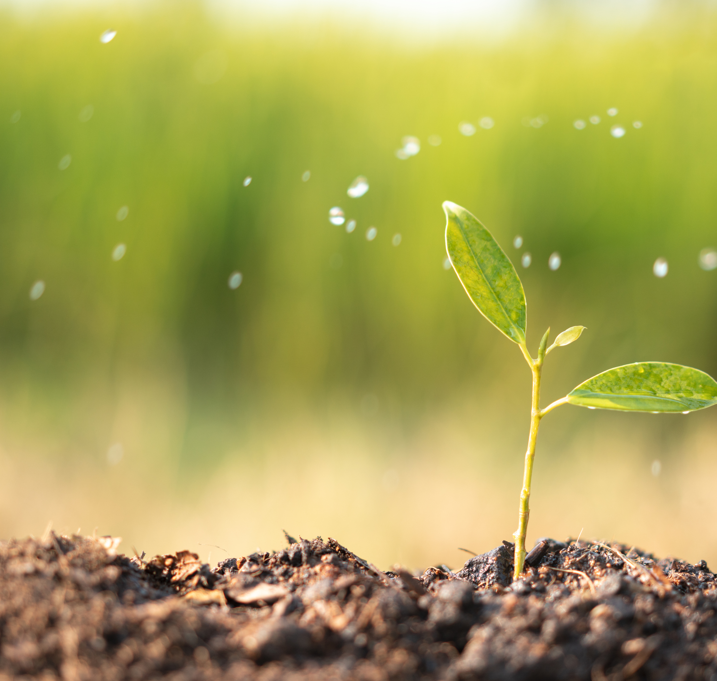
Mark 4
Mark 4:21–25 (ESV)
21 And he said to them, “Is a lamp brought in to be put under a basket, or under a bed, and not on a stand? 22 For nothing is hidden except to be made manifest; nor is anything secret except to come to light. 23 If anyone has ears to hear, let him hear.”
24 And he said to them, “Pay attention to what you hear: with the measure you use, it will be measured to you, and still more will be added to you. 25 For to the one who has, more will be given, and from the one who has not, even what he has will be taken away.”
Notes:
In the parallel account in Matthew 5:15-16 Jesus also adds “In the same way, let your light shine before others, so that they may see your good works and give glory to your Father who is in heaven.” (ESV)
Shining out into the world is part of the purpose of being a disciple of Jesus.
And the truth will come out anyway.
So own it! “Nail your colours to the mast.”
V25 here is repeated in other parables like Matthew 25: the parable of the talents. It seems to refer to God’s servants being rewarded for how they bring glory to God. What “they have” is the spiritual result of their labour which they present to God, and they will be given greater reward and opportunity. Note that in those parables, all the servants that ‘turn a profit’ with the resources they were given get told “Well done, good and faithful servant. You have been faithful over a little; I will set you over much. Enter into the joy of your master.”

Slide 8
Mark 4
Mark 4:26–29 (ESV)
26 And he said, “The kingdom of God is as if a man should scatter seed on the ground. 27 He sleeps and rises night and day, and the seed sprouts and grows; he knows not how.
28 The earth produces by itself, first the blade, then the ear, then the full grain in the ear.
29 But when the grain is ripe, at once he puts in the sickle, because the harvest has come.”
Notes:
1 minute to mull it over
1 minute for responses

Slide 9
Mark 4 - highlighted
Mark 4:26–29 (ESV)
26 And he said, “The kingdom of God is as if a man should scatter seed on the ground. 27 He sleeps and rises night and day, and the seed sprouts and grows; he knows not how.
28 The earth produces by itself, first the blade, then the ear, then the full grain in the ear.
29 But when the grain is ripe, at once he puts in the sickle, because the harvest has come.”
Notes:
1 Corinthians 3:5–9 (ESV)
5 What then is Apollos? What is Paul? Servants through whom you believed, as the Lord assigned to each. 6 I planted, Apollos watered, but God gave the growth. 7 So neither he who plants nor he who waters is anything, but only God who gives the growth. 8 He who plants and he who waters are one, and each will receive his wages according to his labor. 9 For we are God’s fellow workers. You are God’s field, God’s building.

Slide 10
Mark 4
Mark 4:21–34 (ESV)
30 And he said, “With what can we compare the kingdom of God, or what parable shall we use for it? 31 It is like a grain of mustard seed, which, when sown on the ground, is the smallest of all the seeds on earth, 32 yet when it is sown it grows up and becomes larger than all the garden plants and puts out large branches, so that the birds of the air can make nests in its shade.”
Notes:
1 minute to mull it over
1 minute for responses

Slide 11
Mark 4 - highlighted
Mark 4:21–34 (ESV)
30 And he said, “With what can we compare the kingdom of God, or what parable shall we use for it? 31 It is like a grain of mustard seed, which, when sown on the ground, is the smallest of all the seeds on earth, 32 yet when it is sown it grows up and becomes larger than all the garden plants and puts out large branches, so that the birds of the air can make nests in its shade.”

Slide 12
John 4
John 4:36–38 (ESV)
36 Already the one who reaps is receiving wages and gathering fruit for eternal life, so that sower and reaper may rejoice together. 37 For here the saying holds true, ‘One sows and another reaps.’
38 I sent you to reap that for which you did not labor. Others have labored, and you have entered into their labor.”

Slide 13
John 4 - highlighted
John 4:36–38 (ESV)
36 Already the one who reaps is receiving wages and gathering fruit for eternal life,
so that sower and reaper may rejoice together.
37 For here the saying holds true, ‘One sows and another reaps.’
38 I sent you to reap that for which you did not labor. Others have labored, and you have entered into their labor.”

Slide 14
Paul’s Charge to Timothy
2 Timothy 4:1–5 (ESV)
1 I charge you in the presence of God and of Christ Jesus, who is to judge the living and the dead, and by his appearing and his kingdom:
2 preach the word; be ready in season and out of season; reprove, rebuke, and exhort, with complete patience and teaching.
3 For the time is coming when people will not endure sound teaching, but having itching ears they will accumulate for themselves teachers to suit their own passions, 4 and will turn away from listening to the truth and wander off into myths.
5 As for you, always be sober-minded, endure suffering, do the work of an evangelist, fulfill your ministry.

Slide 15

What have we learned?

